Slide 1
SafeAir Data Analytics Platform
Architecture and data pipelines

Slide 2
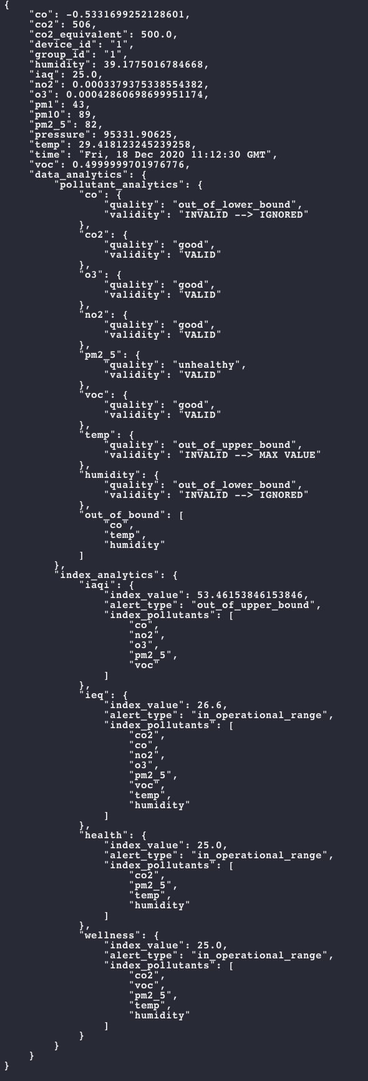
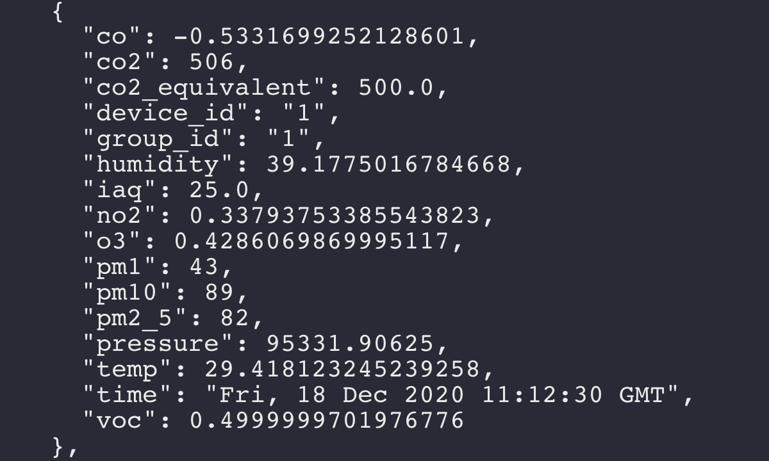
API Input → Analytics Output (JSON)
Analytics Output
(JSON)
API reading
(every minute)

Slide 3
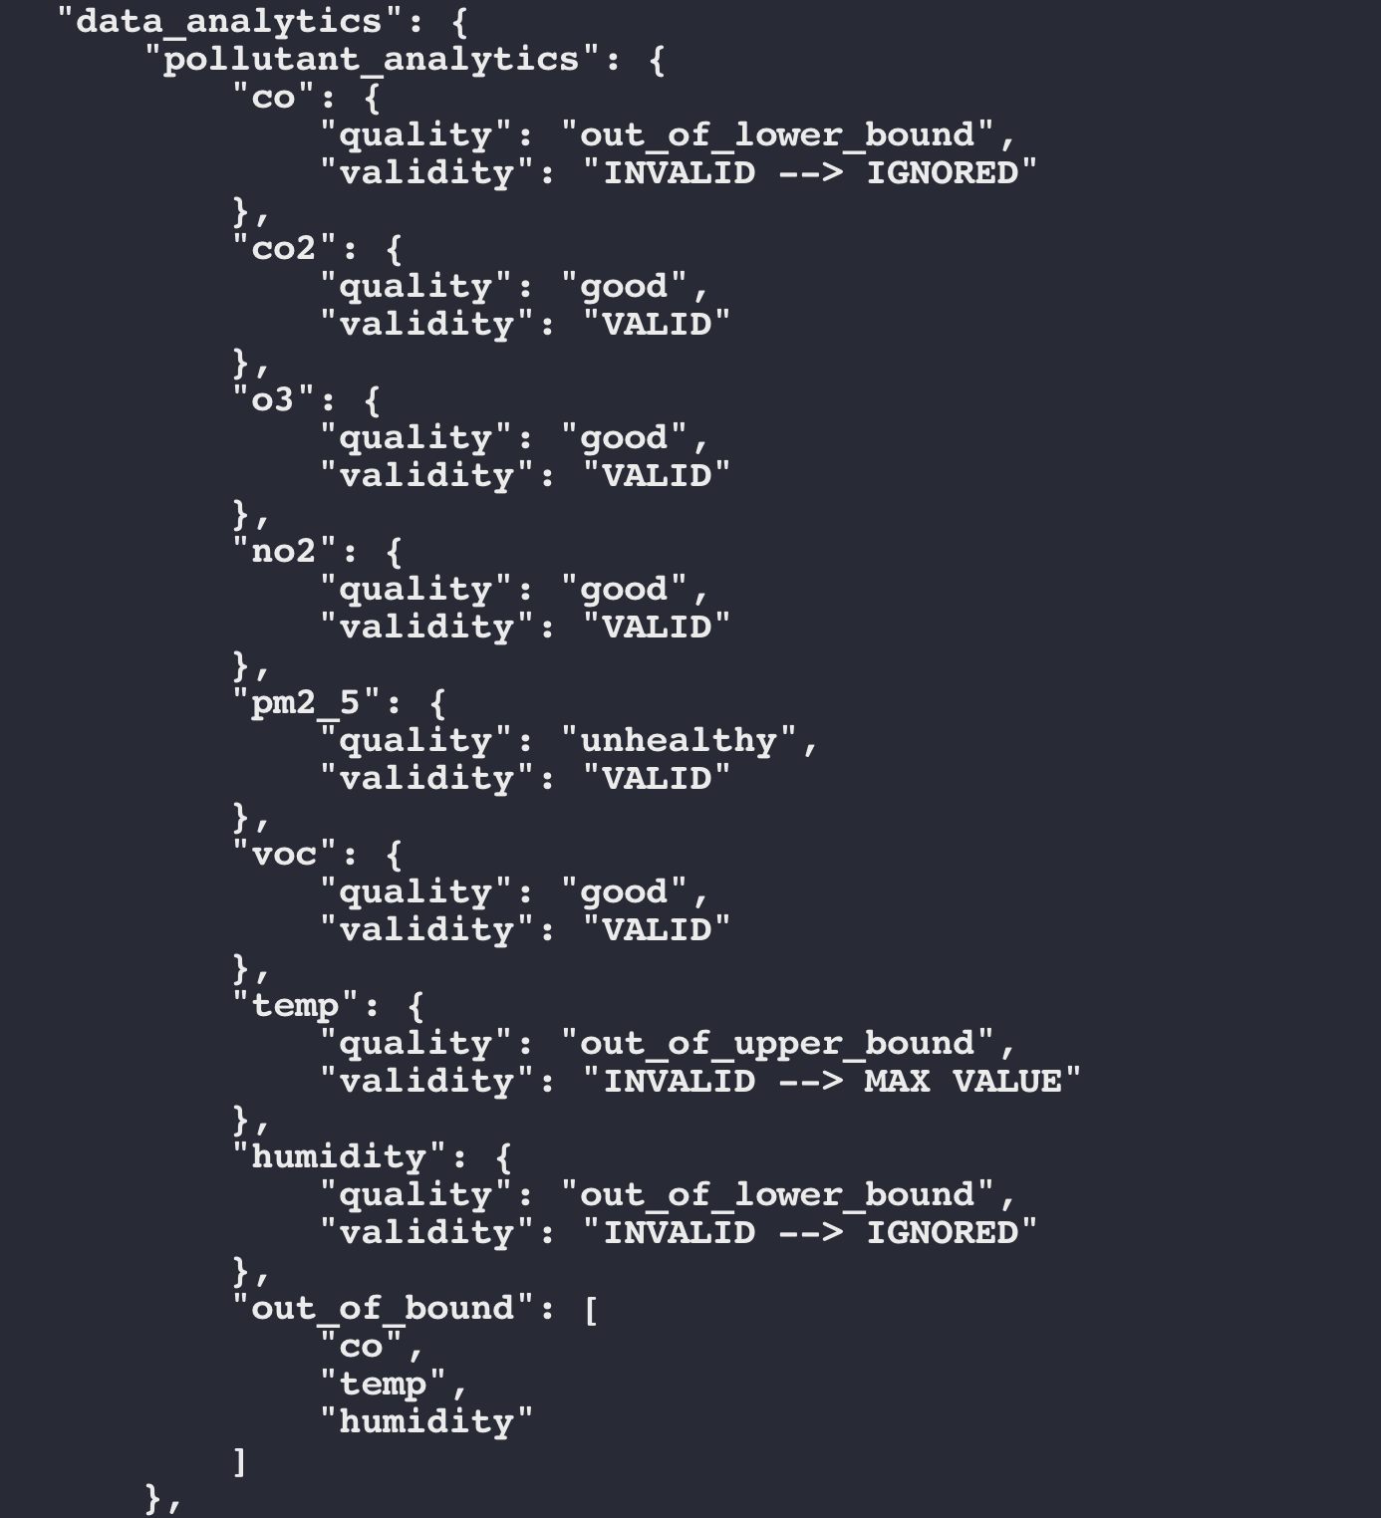
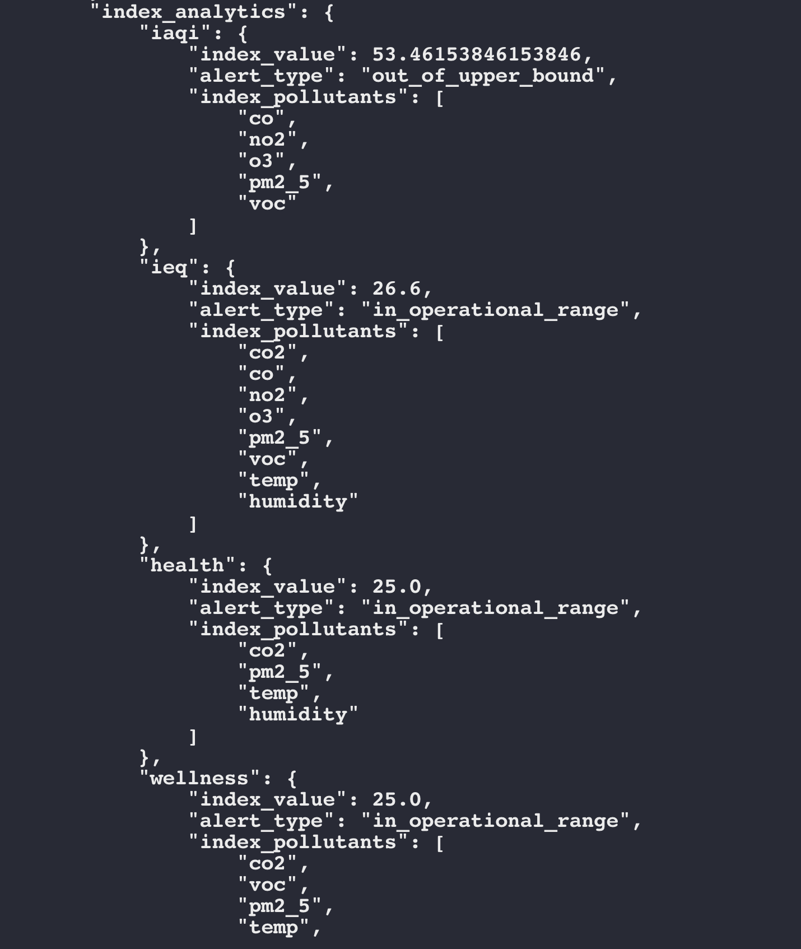
Output → Data Analytics = (Pollutant Analytics, Index Analytics)
Pollutant
Analytics
Index Analytics

Slide 4
Data Architecture - Ground Work
Data Processing
Stack (LIFO)
Analytics
Consolidator
API Data
IAQ
Index Engine
IEQ
Index Engine
Alert Analytics
Engine
Output
Writer
Health
Index Engine
JSON Analytics (output)
Wellness
Index Engine
User settings
(Index ranges)
From SafeAir App

Slide 5
Requirements
Python 3.3+

Slide 6


Services on top can be easily build - Future Directions
Alerting Services
Offsets
Alert messages (contextual and actionable)
Decision rules for suggesting the user to re-configure index ranges.
Predictive/Recommendation Services
Suggest index ranges upon user behaviour change.
Alert about future danger/hazard.
Data Pipeline for Analytics groundwork has been laid.

Slide 7
Directions of further additions and improvements
Code Development:
Multiprocessing (not needed right away, but might be needed if the product grows)
Error/exception hierarchy: logging of exceptions and errors
Testing with real data

